Slide 1

STATS 330: Lecture 15
Variable Selection 2
330 lecture 15
Notes:
STATS 330 lect 15

Slide 2
Variable selection
Aim of today’s lecture
To describe some further techniques for selecting the explanatory variables for a regression
To compare the techniques and apply them to several examples
330 lecture 15
Notes:
STATS 330 lect 15

Slide 3
Variable selection: Stepwise methods
In the previous lecture, we mentioned a second class of methods for variable selection: stepwise methods
The idea here is to perform a sequence of steps to eliminate variables from the regression, or add variables to the regression (or perhaps both).
Three variations: Backward Elimination (BE), Forward Selection (FS) and Stepwise Regression (a combination of BE and FS)
Invented when computing power was weak
330 lecture 15
Notes:
STATS 330 lect 15

Slide 4
Backward elimination
Start with the full model with k variables
Remove variables one at a time, record AIC
Retain best (k-1)-variable model (smallest AIC)
Repeat 2 and 3 until no improvement in AIC
330 lecture 15
Notes:
STATS 330 lect 15

Slide 5
R code
Use R function step
Need to define an initial model (the full model in this case, as produced by the R function lm) and a scope (a formula defining the full model)
ffa.lm = lm(ffa~., data=ffa.df)
step(ffa.lm, scope=formula(ffa.lm),
direction=“backward”)
330 lecture 15

Slide 6
> step(ffa.lm, scope=formula(ffa.lm),direction="backward")
Start: AIC=-56.6
ffa ~ age + weight + skinfold
Df Sum of Sq RSS AIC
- skinfold 1 0.00305 0.79417 -58.524
<none> 0.79113 -56.601
- age 1 0.11117 0.90230 -55.971
- weight 1 0.52985 1.32098 -48.347
Step: AIC=-58.52
ffa ~ age + weight
Df Sum of Sq RSS AIC
<none> 0.79417 -58.524
- age 1 0.11590 0.91007 -57.799
- weight 1 0.54993 1.34410 -50.000
Call:
lm(formula = ffa ~ age + weight, data = ffa.df)
Coefficients:
(Intercept) age weight
3.78333 -0.01783 -0.02027
Smallest AIC
Smallest
AIC
330 lecture 15
Notes:
STATS 330 lect 15

Slide 7
Forward selection
Start with a null model
Fit all one-variable models in turn. Pick the model with the best AIC
Then, fit all two variable models that contain the variable selected in 2. Pick the one for which the added variable gives the best AIC
Continue in this way until adding further variables does not improve the AIC
330 lecture 15
Notes:
STATS 330 lect 15

Slide 8
Forward selection (cont)
Use R function step
As before, we need to define an initial model (the null model in this case and a scope (a formula defining the full model)
# R code: first make null model:
ffa.lm = lm(ffa~., data=ffa.df)
null.lm = lm(ffa~1, data=ffa.df)# then do FS
step(null.lm, scope=formula(ffa.lm),
direction=“forward”)
330 lecture 15
Notes:
STATS 330 lect 15

Slide 9
Step: output (1)
Starts with constant term only
> step(null.lm, scope=formula(ffa.lm), direction="forward")
Start: AIC=-49.16
ffa ~ 1
Df Sum of Sq RSS AIC
+ weight 1 0.63906 0.91007 -57.799
+ age 1 0.20503 1.34410 -50.000
<none> 1.54913 -49.161
+ skinfold 1 0.00145 1.54768 -47.179
Results of all possible 1 (& 0) variable models. Pick weight (smallest AIC)
330 lecture 15
Notes:
STATS 330 lect 15

Slide 10
Final model
Call:
lm(formula = ffa ~ weight + age, data = reg.obj$model)
Coefficients:
(Intercept) weight age
3.78333 -0.02027 -0.01783
330 lecture 15
Notes:
STATS 330 lect 15

Slide 11
Stepwise Regression
Combination of BE and FS
Start with null model
Repeat:
  one step of FS
  one step of BE
Stop when no improvement in AIC is possible
330 lecture 15
Notes:
STATS 330 lect 15

Slide 12
Code for Stepwise Regression
# first define null model
null.lm<-lm(ffa~1, data=ffa.df)
# then do stepwise regression, using the R function “step”
step(null.model,
scope=formula(ffa.lm),
direction=“both”)
Note difference from FS (use “both” instead of “forward”)
330 lecture 15
Notes:
STATS 330 lect 15

Slide 13
Example: Evaporation data
Recall from Lecture 14: variables are
evap: the amount of moisture evaporating from the soil in the 24 hour period (response)
maxst: maximum soil temperature over the 24 hour period
minst: minimum soil temperature over the 24 hour period
avst: average soil temperature over the 24 hour period
maxat: maximum air temperature over the 24 hour period
minat: minimum air temperature over the 24 hour period
avat: average air temperature over the 24 hour period
maxh: maximum air temperature over the 24 hour period
minh: minimum air temperature over the 24 hour period
avh: average air temperature over the 24 hour period
wind: average wind speed over the 24 hour period.
330 lecture 15
Notes:
STATS 330 lect 15

Slide 14
Stepwise
evap.lm = lm(evap~., data=evap.df)
null.model<-lm(evap ~ 1, data = evap.df)
step(null.model, formula(evap.lm), direction=“both”)
Final output:
Call:
lm(formula = evap ~ maxh + maxat + wind + maxst + avst, data = evap.df)
Coefficients:
(Intercept) maxh maxat wind maxst avst
70.53895 -0.32310 0.36375 0.01089 -0.48809 1.19629
330 lecture 15
Notes:
STATS 330 lect 15

Slide 15
Conclusion
APR suggested model with variables
maxat, maxh, wind (CV criterion)
avst, maxst, maxat, maxh (BIC)
avst, maxst, maxat, minh, maxh (AIC)
Stepwise gave model with variables
maxat, avst, maxst, maxh, wind
330 lecture 15
Notes:
STATS 330 lect 15

Slide 16
Caveats
There is no guarantee that the stepwise algorithm will find the best predicting model
The selected model usually has an inflated R², and standard errors and p-values that are too low.
Collinearity can make the model selected quite arbitrary – collinearity is a data property, not a model property.
For both methods of variable selection, do not trust p-values from the final fitted model – resist the temptation to delete variables that are not significant.
330 lecture 15
Notes:
STATS 330 lect 15

Slide 17
A Cautionary Example
Body fat data: see Assignment 3, 2010
Response: percent body fat (PercentB)
14 Explanatory variables:
Age, Weight, Height, Adi, Neck, Chest, Abdomen, Hip, Thigh, Knee, Ankle, Bicep, Forearm, Wrist
Assume true model:
PercentB ~ Age + Adi + Neck + Chest + Abdomen + Hip + Thigh + Forearm + Wrist
Coefficients:
(Intercept) Age Adi Neck Chest Abdomen Hip Thigh Forearm Wrist
  3.27306 0.06532 0.47113 -0.39786 -0.17413 0.80178 -0.27010 0.17371 0.25987 1.72945
Sigma = 3.920764
330 lecture 15

Slide 18
Example (cont)
Using R, generate 200 sets of data from this model, using the same X’s but new random errors each time.
For each set, choose a model by BE, record coefficients. If a variable is not in chosen model, record as 0.
Results summarized on next slide
330 lecture 15

Slide 19
Results (1)
true coef % selected
(out of 200)
Age 0.065 78
Weight 0.000 33
Height 0.000 42
Adi 0.471 54
Neck -0.398 61
Chest -0.174 67
Abdomen 0.802 100
Hip -0.270 71
Thigh 0.174 47
Knee 0.000 18
Ankle 0.000 16
Bicep 0.000 18
Forearm 0.260 51
Wrist -1.729 99
True model selected only 6 out of 200 times!
330 lecture 15

Slide 20
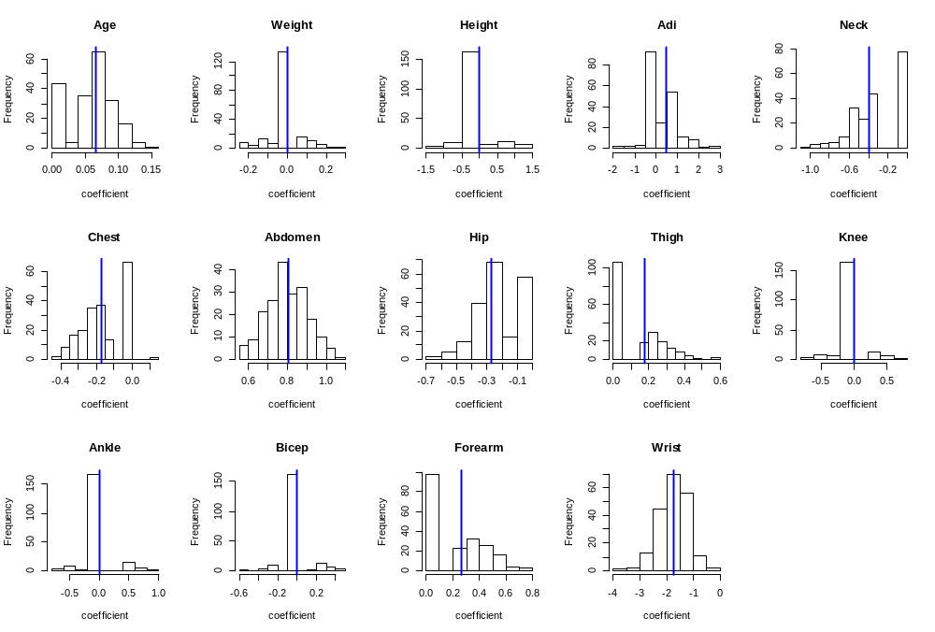
Distribution of estimates
330 lecture 15

Slide 21
Bias in coefficient of Abdomen
Suppose we want to estimate the coefficient of Abdomen. Various strategies:
Pick model using BE, use coef of abdomen in chosen model.
Pick model using BIC, use coef of abdomen in chosen model.
Pick model using AIC, use coef of abdomen in chosen model.
Pick model using Adj R2, use coef of abdomen in chosen model.
Use coef of abdomen in full model
Which is best? Can generate 200 data sets, and compare
330 lecture 15

Slide 22
Bias results
Table gives MSE i.e. average of squared differences (estimate-true value)² x 10⁴ averaged over all 200 replications
Thus, full model is best!
Full | BE | BIC | AIC | S²
7.39 | 9.03 | 11.59 | 12.07 | 10.33
330 lecture 15

Slide 23
Estimating the “optimism” in R²
We noted (caveats slide 16) that the R² for the selected model is usually higher than the R² for the model fitted to new data.
How can we adjust for this?
If we have plenty of data, we can split the data into a “training set” and a “test set”, select the model using the training set, then calculate the R² for the test set.
330 lecture 15

Slide 24
Example: the Georgia voting data
In the 2000 US presidential election, some voters had their ballots declared invalid for different reasons.
In this data set, the response is the “undercount” (the difference between the votes cast and the votes declared valid).
Each observation is a Georgia county, of which there were 159. We removed 4 outliers, leaving 155 counties.
We will consider a model with 5 explanatory variables: undercount ~ perAA+rural+gore+bush+other
Data is in the faraway package
330 lecture 15

Slide 25
Calculating the optimism
We split the data into 2 parts at random, a training set of 80 and a test set of 75.
Using the training set, we selected a model using stepwise regression and calculated the R².
We then took the chosen model and recalculated the R² using the test set. The difference is the “optimism”
We repeated for 50 random splits of 80/75, getting 50 training set R²’s and 50 test set R²’s.
Boxplots of these are shown next
330 lecture 15

Slide 26
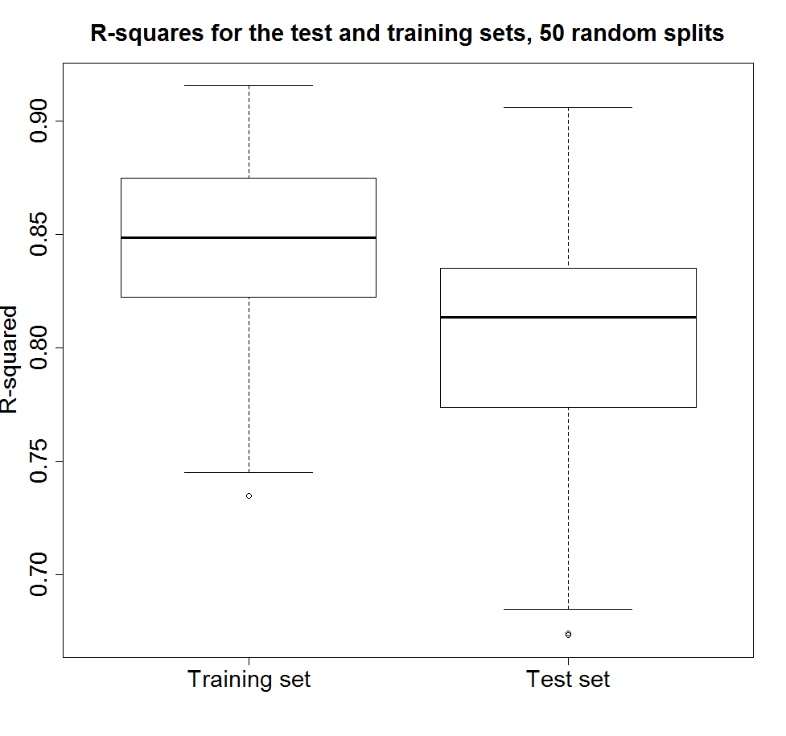
Note that the training R²’s tend to be bigger
330 lecture 15

Slide 27
Optimism
We can also calculate the optimism for the 50 splits: Opt = training R² – test R².
> stem(Opt)
The decimal point is 1 digit(s) to the left of the |
-1 | 311
-0 | 75
-0 | 32221100
0 | 0112222233444444 Optimism tends to be
0 | 55666899 positive.
1 | 011112344
1 | 57
2 | 34
330 lecture 15

Slide 28
What if there is no test set?
If the data are too few to split into training and test sets, and we chose the model using all the data and compute the R², it will most likely be too big.
Perhaps we can estimate the optimism and subtract it off the R² for the chosen model, thus “correcting” the R².
We need to estimate the optimism averaged over all possible data sets.
But we have only one! How to proceed?
330 lecture 15

Slide 29
Estimating the optimism
The optimism is
R²(SWR,data) – “True R²”
Depends on the true unknown distribution of the data
Don’t know this but it is approximated by the “empirical distribution” which puts probability 1/n at each data point
NB: SWR = stepwise regression
330 lecture 1

Slide 30
Resampling
We can draw a sample from the empirical distribution by choosing a sample of size n chosen at random with replacement from the original data (n= number of observations in the original data).
Also called a “bootstrap sample” or a “resample”
330 lecture 15

Slide 31
“Empirical optimism”
The “empirical optimism” is
R²(SWR, resampled data) –
R²(SWR, original data)
We can generate as many values of this estimate as we like by repeatedly drawing samples from the empirical distribution, or “resampling”
330 lecture 15

Slide 32
Resampling (cont)
To correct the R²:
Compute the empirical optimism
Repeat for say 200 resamples, average the 200 optimisms.
This is our estimated optimism.
Correct the original R² for the chosen model by subtracting off the estimated optimism.
This is the “bootstrap corrected” R².
330 lecture 15

Slide 33
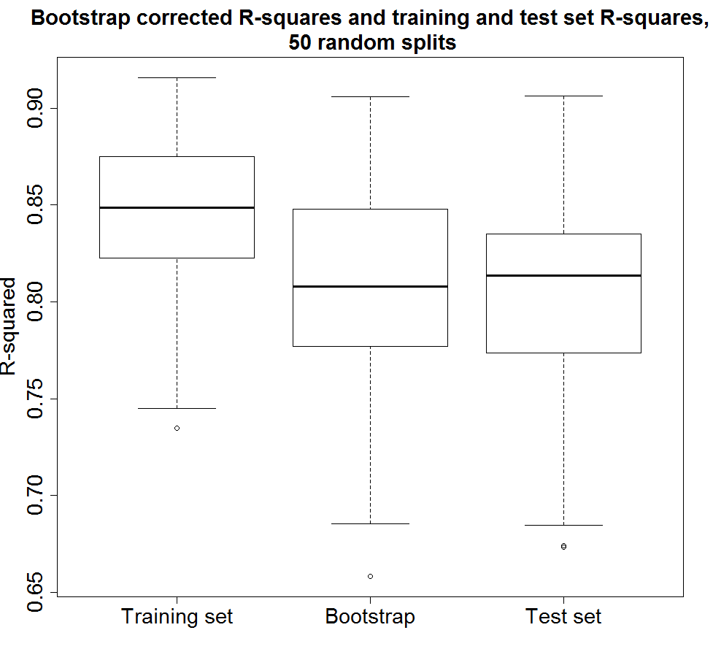
How well does it work
330 lecture 15

Slide 34
Bootstrap estimate of prediction error
Can also use the bootstrap to estimate prediction error.
Calculating the prediction error from the training set underestimates the error.
We estimate the “optimism” from a resample
Repeat and average, as before.
330 lecture 15

Slide 35
Estimating Prediction errors in R
> ga.lm=lm(undercount~perAA+rural+gore+bush+other, data=gavote2)
> cross.val(ga.lm)
Cross-validated estimate of root
mean square prediction error = 244.2198
> err.boot(ga.lm)
$err
[1] 43944.99
$Err
[1] 55544.95
> sqrt(55544.95)
[1] 235.6798
Training set estimate, too low
Bootstrap-corrected estimate
330 lecture 15

Slide 36
Example: prediction error
Body fat data: prediction strategies
Pick model with min CV, estimate prediction error
Pick model with min BOOT, estimate prediction error
Use full model, estimate prediction error
330 lecture 15

Slide 37
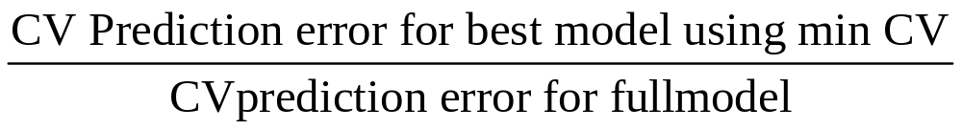
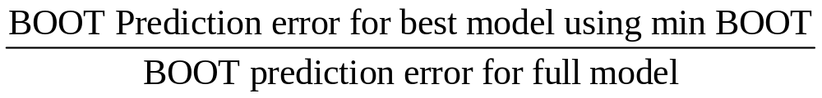
Prediction example (cont)
Generate 200 samples. For each sample
calculate ratio (using CV estimate)
Calculate ratio (using BOOT estimate)
Average ratios over 200 samples
330 lecture 15

Slide 38
Results
Method | CV | BOOT
Ratio | 0.953 | 0.958
CV and BOOT in good agreement. Both ratios less than 1, so selecting subsets by CV or BOOT is giving better predictions.
330 lecture 15

